Slide 1
Modeling and Simulation of Magnetic Transmission Lines
Muhammad Shamaas
2018-MS-EE-4

Slide 2
Applications of Magnetic Transmission Lines
Inductors and Magnetic Amplifiers.
Transformers: Power Transformers, Ferro-resonant CVT, Wideband Transformers, Pulse Transformers.
AC / DC Machines.
Computers and RF Electronics: Noise and skin effect suppression using magnetic thin films, ferrite beads and ribbons.
Directional Couplers and Magnetometers.
Induction Heaters and Magneto-resistive Sensors.
Gyromagnetic Devices: Microwave generators and Magnetic Resonance Imaging.

Slide 3
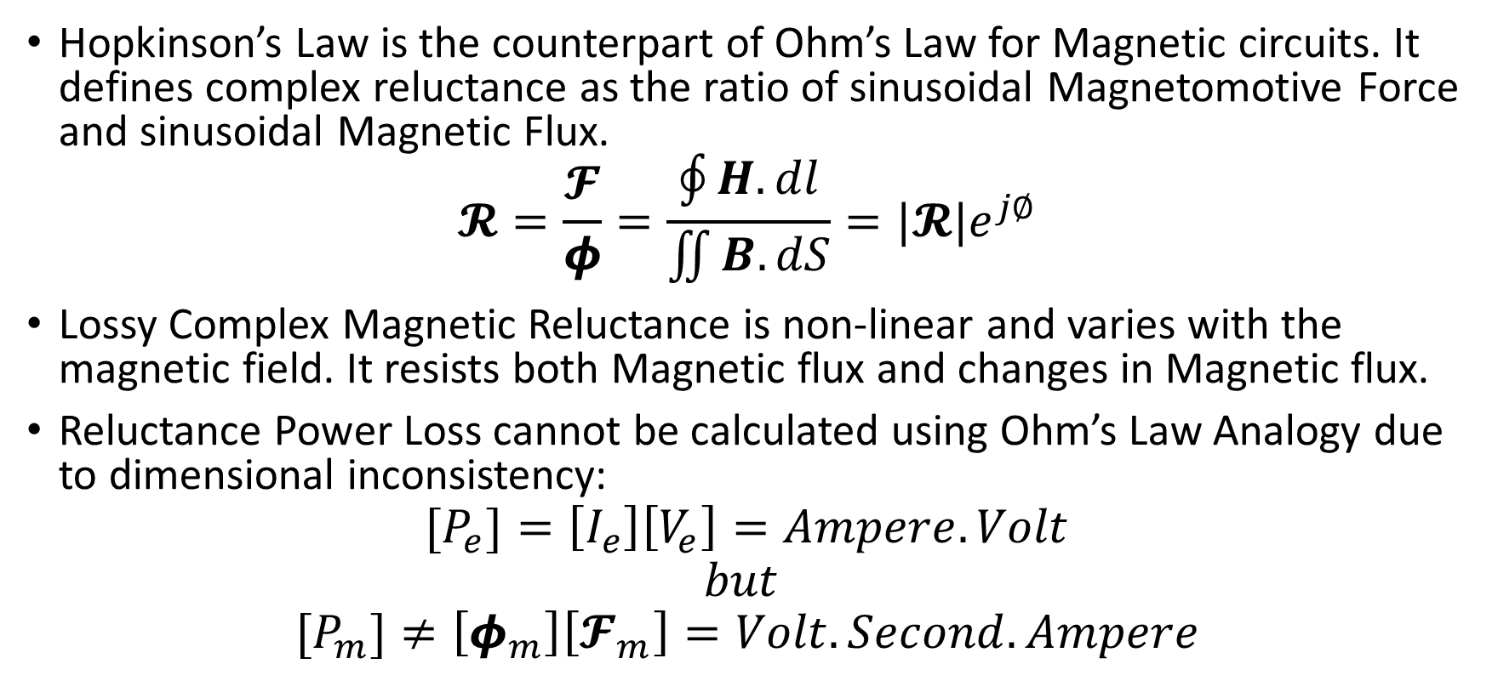
Lossy Complex Magnetic Reluctance Model for Magnetic Circuits
Hopkinson’s Law is the counterpart of Ohm’s Law for Magnetic circuits. It defines complex reluctance as the ratio of sinusoidal Magnetomotive Force and sinusoidal Magnetic Flux.
$$𝓡=\frac{𝓕}{φ}=\frac{\oint{H.dl}}{\iint{B.dS}}=|𝓡|e^{j∅}$$
Lossy Complex Magnetic Reluctance is non-linear and varies with the magnetic field. It resists both Magnetic flux and changes in Magnetic flux.
Reluctance Power Loss cannot be calculated using Ohm’s Law Analogy due to dimensional inconsistency:
$$[P_{e}]=\left[I_{e}\right]\left[V_{e}\right]=Ampere.Volt$$
$$but$$
$${[P}_{m}]≠\left[φ_{m}\right]\left[𝓕_{m}\right]=Volt.Second.Ampere$$

Slide 4
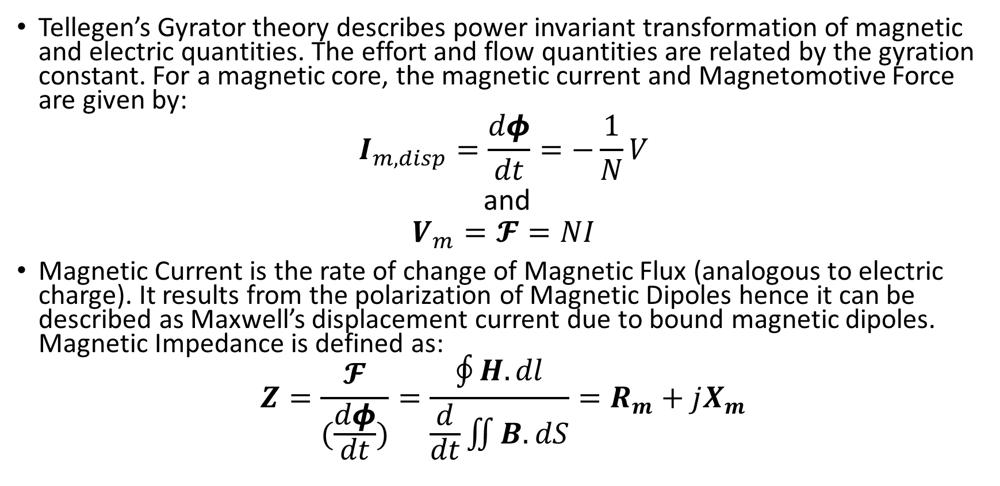
Power Invariant Gyrator-Capacitor Model for Magnetic Circuits
Tellegen’s Gyrator theory describes power invariant transformation of magnetic and electric quantities. The effort and flow quantities are related by the gyration constant. For a magnetic core, the magnetic current and Magnetomotive Force are given by:
$$I_{m,disp}=\frac{dφ}{dt}=−\frac{1}{N}V$$
and
$$V_{m}=𝓕=NI$$
Magnetic Current is the rate of change of Magnetic Flux (analogous to electric charge). It results from the polarization of Magnetic Dipoles hence it can be described as Maxwell’s displacement current due to bound magnetic dipoles. Magnetic Impedance is defined as:
$$Z=\frac{𝓕}{(\frac{dφ}{dt})}=\frac{\oint{H.dl}}{\frac{d}{dt}\iint{B.dS}}=R_{m}+jX_{m}$$

Slide 5
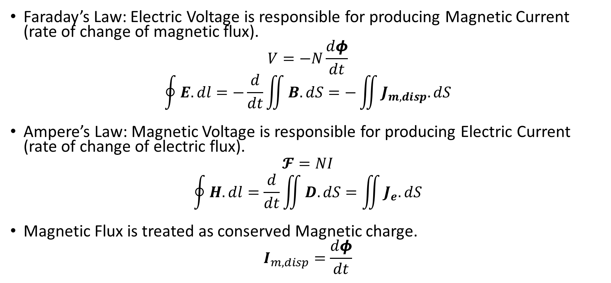
Implications of Gyrator-Capacitor Model
Faraday’s Law: Electric Voltage is responsible for producing Magnetic Current (rate of change of magnetic flux).
$$V=−N\frac{dφ}{dt}$$
$$\oint{E.dl}=−\frac{d}{dt}\iint{B.dS}=−\iint{J_{m,disp}.dS}$$
Ampere’s Law: Magnetic Voltage is responsible for producing Electric Current (rate of change of electric flux).
$$𝓕=NI$$
$$\oint{H.dl}=\frac{d}{dt}\iint{D.dS}=\iint{J_{e}.dS}$$
Magnetic Flux is treated as conserved Magnetic charge.
$$I_{m,disp}=\frac{dφ}{dt}$$

Slide 6
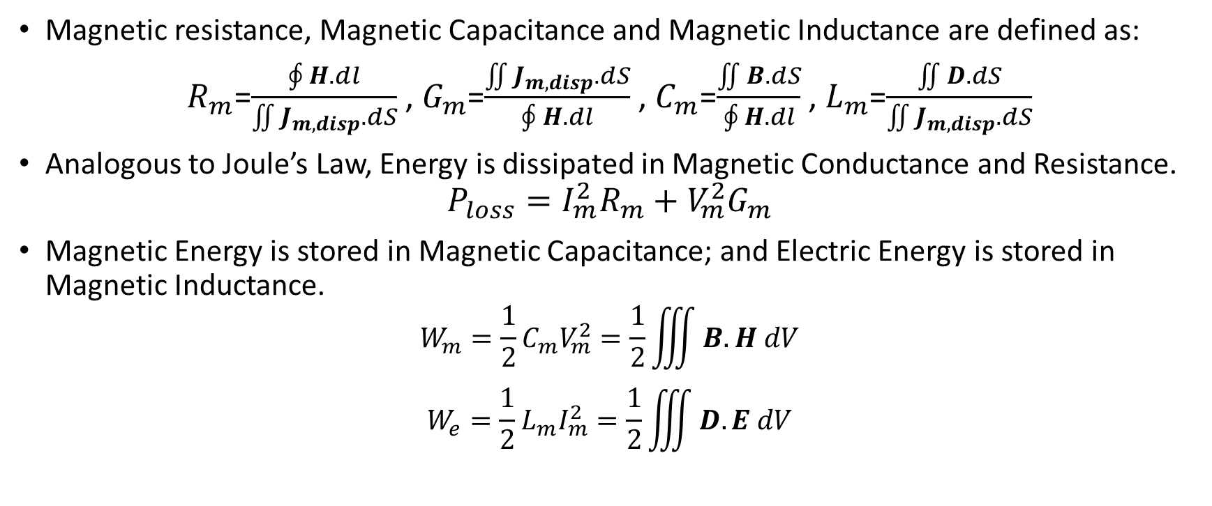
Energy Loss and Energy Storage in Gyrator-Capacitor Model
Magnetic resistance, Magnetic Capacitance and Magnetic Inductance are defined as:
$R_{m}$=$\frac{\oint{H.dl}}{\iint{J_{m,disp}.dS}}$ , $G_{m}$=$\frac{\iint{J_{m,disp}.dS}}{\oint{H.dl}}$ , $C_{m}$=$\frac{\iint{B.dS}}{\oint{H.dl}}$ , $L_{m}$=$\frac{\iint{D.dS}}{\iint{J_{m,disp}.dS}}$
Analogous to Joule’s Law, Energy is dissipated in Magnetic Conductance and Resistance.
$$P_{loss}=I_{m}^{2}R_{m}+V_{m}^{2}G_{m}$$
Magnetic Energy is stored in Magnetic Capacitance; and Electric Energy is stored in Magnetic Inductance.
$$W_{m}=\frac{1}{2}{C_{m}V}_{m}^{2}=\frac{1}{2}\iiint{B.H dV}$$
$$W_{e}=\frac{1}{2}{L_{m}I}_{m}^{2}=\frac{1}{2}\iiint{D.E dV}$$
R=effort variable/flow variable. G=flow variable/effort variable. C=charge variable/effort variable. L=dual charge variable/flow variable.

Slide 7
Comparison of Complex Reluctance Model and Power Invariant Model
 | Reluctance Model | Gyrator-Capacitor Model
Conserved Quantity | ? | Magnetic Flux
Flow Variable | Magnetic Flux | Rate of change of Magnetic Flux
Effort Variable | Magnetomotive Force | Magnetomotive Force
Energy Dissipative Element | Complex Reluctance | Magnetic Resistance and Magnetic Conductance
Electrical Energy Storage Element | Complex Reluctance | Magnetic Inductance
Magnetic Energy Storage Element | Complex Reluctance | Magnetic Capacitance

Slide 8
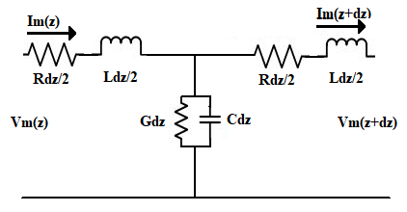
Magnetic Transmission Line Lumped Circuit Model

Slide 9
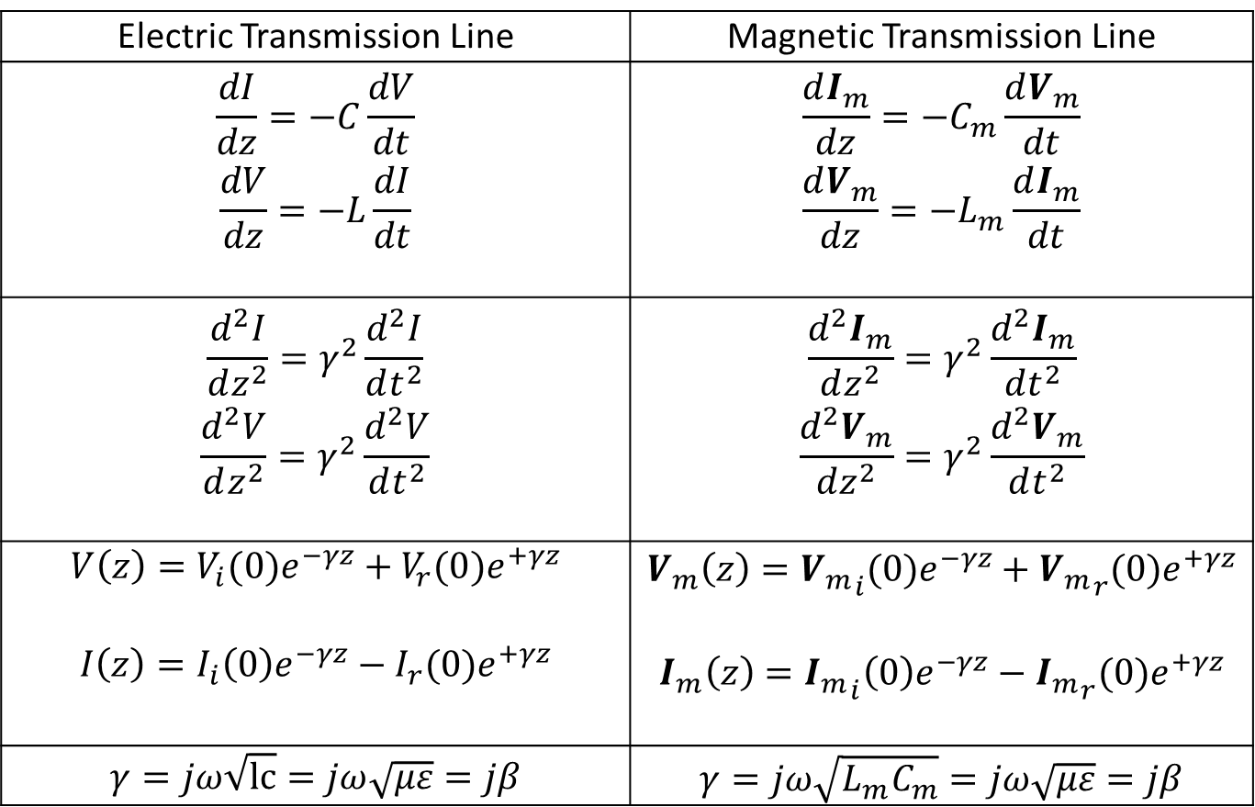
Lossless Magnetic Transmission Line
Electric Transmission Line | Magnetic Transmission Line
$$\frac{dI}{dz}=−C\frac{dV}{dt}$$ $$\frac{dV}{dz}=−L\frac{dI}{dt}$$ | $$\frac{dI_{m}}{dz}=−C_{m}\frac{dV_{m}}{dt}$$ $$\frac{dV_{m}}{dz}=−L_{m}\frac{dI_{m}}{dt}$$
$$\frac{d^{2}I}{dz^{2}}=γ^{2}\frac{d^{2}I}{dt^{2}}$$ $$\frac{d^{2}V}{dz^{2}}=γ^{2}\frac{d^{2}V}{dt^{2}}$$ | $$\frac{d^{2}I_{m}}{dz^{2}}=γ^{2}\frac{d^{2}I_{m}}{dt^{2}}$$ $$\frac{d^{2}V_{m}}{dz^{2}}=γ^{2}\frac{d^{2}V_{m}}{dt^{2}}$$
$$V\left(z\right)=V_{i}(0)e^{−γz}+V_{r}(0)e^{+γz}$$ $$I\left(z\right)=I_{i}\left(0\right)e^{−γz}−I_{r}(0)e^{+γz}$$ | $$V_{m}\left(z\right)={V_{m}}_{i}(0)e^{−γz}+{V_{m}}_{r}(0)e^{+γz}$$ $$I_{m}\left(z\right)={I_{m}}_{i}\left(0\right)e^{−γz}−{I_{m}}_{r}(0)e^{+γz}$$
$$γ=jω\sqrt{lc}=jω\sqrt{με}=jβ$$ | $$γ=jω\sqrt{L_{m}C_{m}}=jω\sqrt{με}=jβ$$

Slide 10
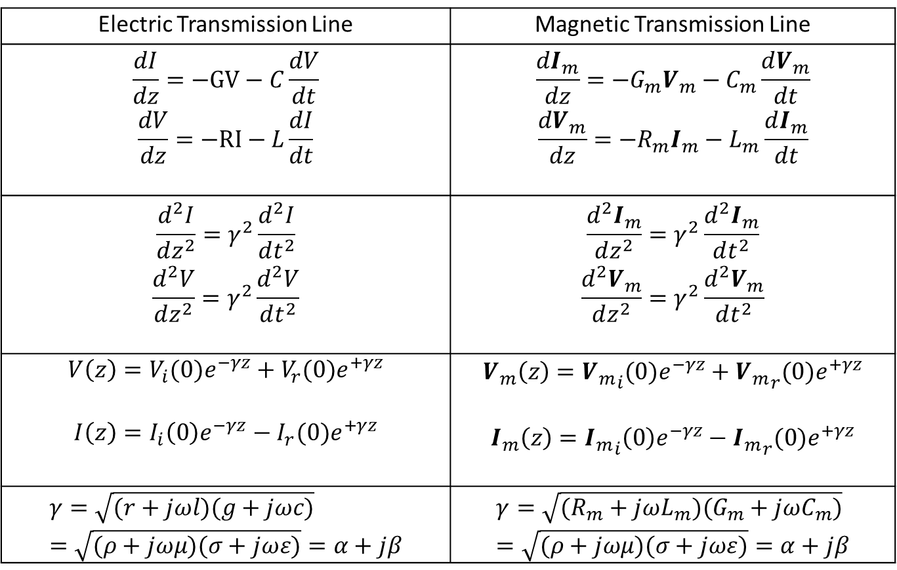
Lossy Magnetic Transmission Line
Electric Transmission Line | Magnetic Transmission Line
$$\frac{dI}{dz}=−GV−C\frac{dV}{dt}$$ $$\frac{dV}{dz}=−RI−L\frac{dI}{dt}$$ | $$\frac{dI_{m}}{dz}=−G_{m}V_{m}−C_{m}\frac{dV_{m}}{dt}$$ $$\frac{dV_{m}}{dz}=−R_{m}I_{m}−L_{m}\frac{dI_{m}}{dt}$$
$$\frac{d^{2}I}{dz^{2}}=γ^{2}\frac{d^{2}I}{dt^{2}}$$ $$\frac{d^{2}V}{dz^{2}}=γ^{2}\frac{d^{2}V}{dt^{2}}$$ | $$\frac{d^{2}I_{m}}{dz^{2}}=γ^{2}\frac{d^{2}I_{m}}{dt^{2}}$$ $$\frac{d^{2}V_{m}}{dz^{2}}=γ^{2}\frac{d^{2}V_{m}}{dt^{2}}$$
$$V\left(z\right)=V_{i}(0)e^{−γz}+V_{r}(0)e^{+γz}$$ $$I\left(z\right)=I_{i}\left(0\right)e^{−γz}−I_{r}(0)e^{+γz}$$ | $$V_{m}\left(z\right)={V_{m}}_{i}(0)e^{−γz}+{V_{m}}_{r}(0)e^{+γz}$$ $$I_{m}\left(z\right)={I_{m}}_{i}\left(0\right)e^{−γz}−{I_{m}}_{r}(0)e^{+γz}$$
$$γ=\sqrt{(r+jωl)(g+jωc)}=\sqrt{(ρ+jωμ)(σ+jωε)}=α+jβ$$ | $$γ=\sqrt{(R_{m}+jωL_{m})(G_{m}+jωC_{m})}=\sqrt{(ρ+jωμ)(σ+jωε)}=α+jβ$$

Slide 11
MEEP: Anisotropy

Slide 12
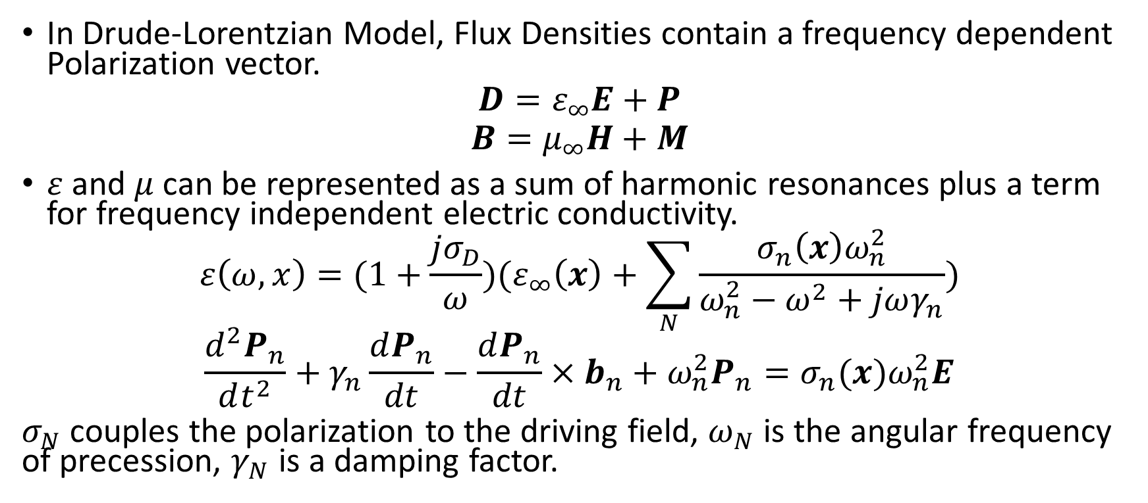
MEEP: Inhomogeneity
In Drude-Lorentzian Model, Flux Densities contain a frequency dependent Polarization vector.
$$D=ε_{∞}E+P$$
$$B=μ_{∞}H+M$$
$ε$ and $μ$can be represented as a sum of harmonic resonances plus a term for frequency independent electric conductivity.
$$ε\left(ω,x\right)=(1+\frac{jσ_{D}}{ω})(ε_{∞}\left(x\right)+\sum_{N}{\frac{σ_{n}\left(x\right)ω_{n}^{2}}{ω_{n}^{2}−ω^{2}+jωγ_{n}}})$$
$$\frac{d^{2}P_{n}}{dt^{2}}+γ_{n}\frac{dP_{n}}{dt}−\frac{dP_{n}}{dt}×b_{n}+ω_{n}^{2}P_{n}=σ_{n}(x)ω_{n}^{2}E$$
$σ_{N}$ couples the polarization to the driving field, $ω_{N}$ is the angular frequency of precession, $γ_{N}$ is a damping factor.

Slide 13
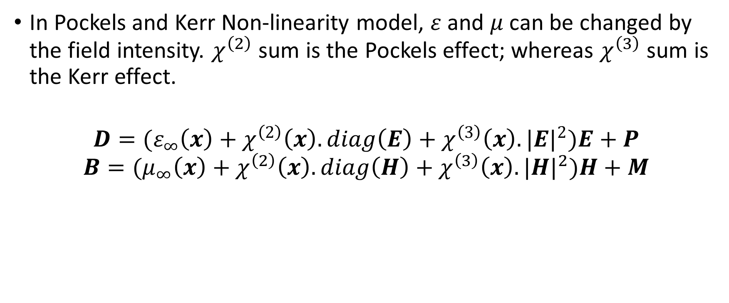
MEEP: Non-Linearity
In Pockels and Kerr Non-linearity model, $ε$ and $μ$can be changed by the field intensity. $χ^{\left(2\right)}$ sum is the Pockels effect; whereas $χ^{\left(3\right)}$ sum is the Kerr effect.
$$D=(ε_{∞}\left(x\right)+χ^{\left(2\right)}\left(x\right).diag\left(E\right)+χ^{\left(3\right)}\left(x\right).{|E|}^{2})E+P$$
$$B=(μ_{∞}\left(x\right)+χ^{\left(2\right)}\left(x\right).diag\left(H\right)+χ^{\left(3\right)}\left(x\right).{|H|}^{2})H+M$$

Slide 14
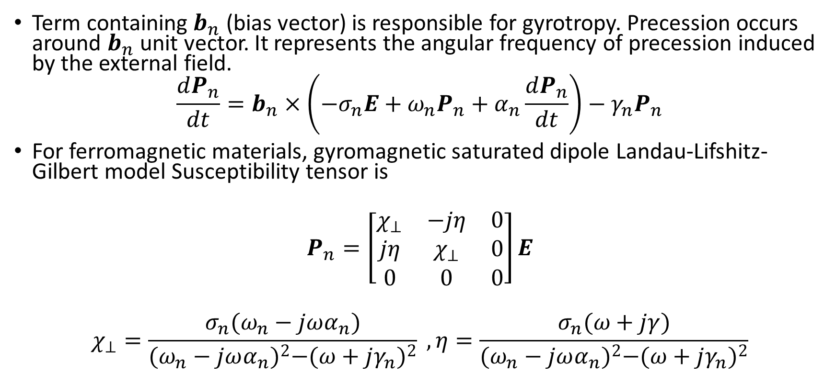
MEEP: Gyrotropy
Term containing $b_{n}$ (bias vector) is responsible for gyrotropy. Precession occurs around $b_{n}$ unit vector. It represents the angular frequency of precession induced by the external field.
$$\frac{dP_{n}}{dt}=b_{n}×\left(−σ_{n}E+ω_{n}P_{n}+α_{n}\frac{dP_{n}}{dt}\right)−γ_{n}P_{n}$$
For ferromagnetic materials, gyromagnetic saturated dipole Landau-Lifshitz-Gilbert model Susceptibility tensor is
$$P_{n}=\left[\begin{matrix}χ_{⊥} & −jη & 0 \\ jη & χ_{⊥} & 0 \\ 0 & 0 & 0\end{matrix}\right]E$$
$$χ_{⊥}=\frac{σ_{n}(ω_{n}−jωα_{n})}{{(ω_{n}−jωα_{n})}^{2}−{(ω+jγ_{n})}^{2}} , η=\frac{σ_{n}(ω+jγ)}{{(ω_{n}−jωα_{n})}^{2}−{(ω+jγ_{n})}^{2}}$$

